Slide 1

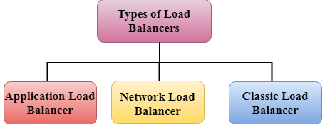
Load Balancing
This services are used for high availability of the applications
Classic LB
Application LB
Network LB

Slide 2
Why use a load balancer?
Spread load across multiple downstream instances
Expose a single point of access (DNS) to your application
Seamlessly handle failures of downstream instances
Do regular health checks to your instances
Provide SSL termination (HTTPS) for your websites
Enforce stickiness with cookies • High availability across zones
Separate public traffic from private traffic
AWS guarantees that it will be working
AWS takes care of upgrades, maintenance, high availability
AWS provides only a few configuration knobs
It costs less to setup your own load balancer but it will be a lot more effort on your end.
It is integrated with many AWS offerings / services
datacumulus.com
You can setup internal(private) or external(public) ELBs

Slide 3
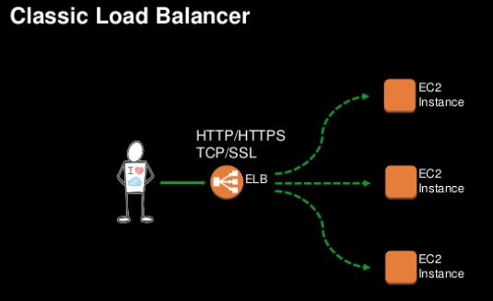
Classic LB - 2009

Slide 4
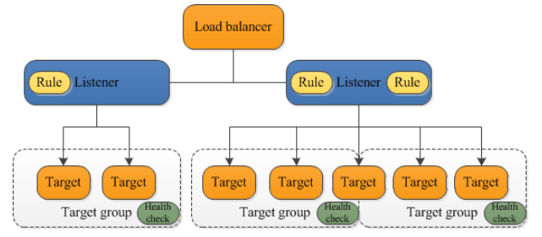
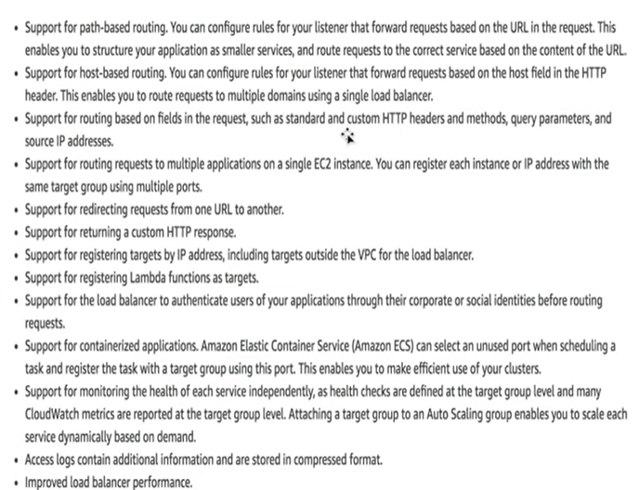
Application LB - 2016
Target-group
Health-Checks
Listeners

Slide 5
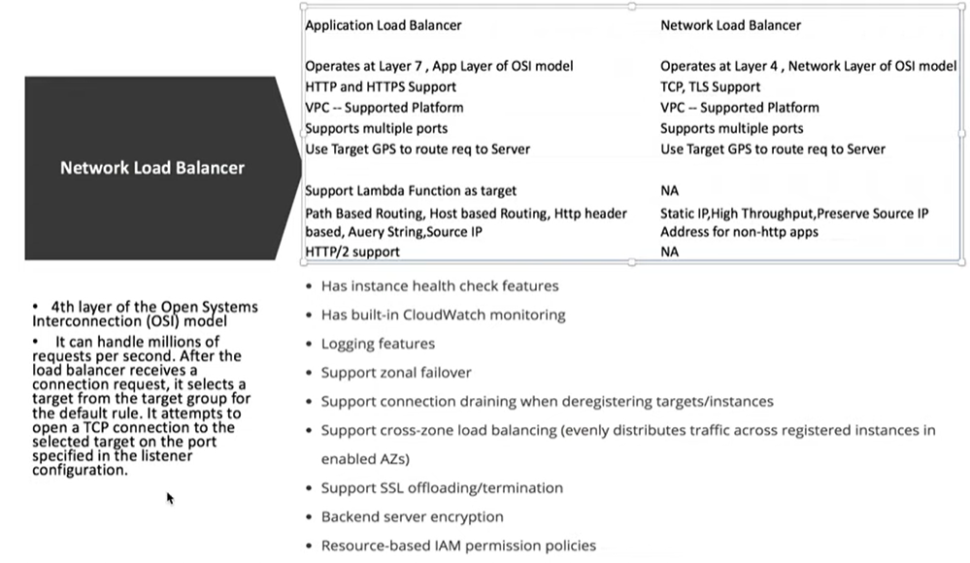
Network LB - 2017

Slide 6
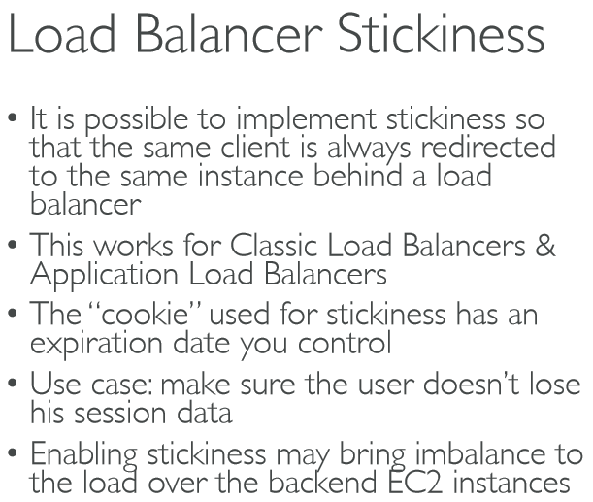
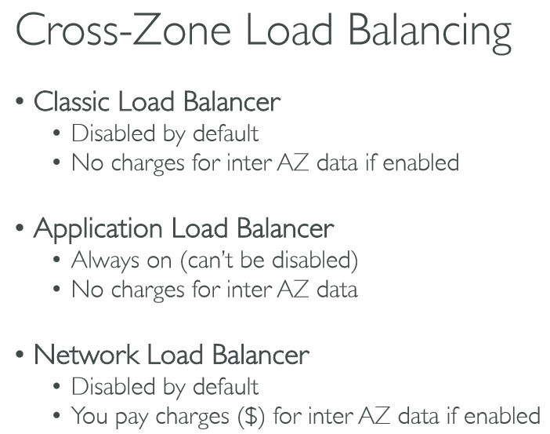
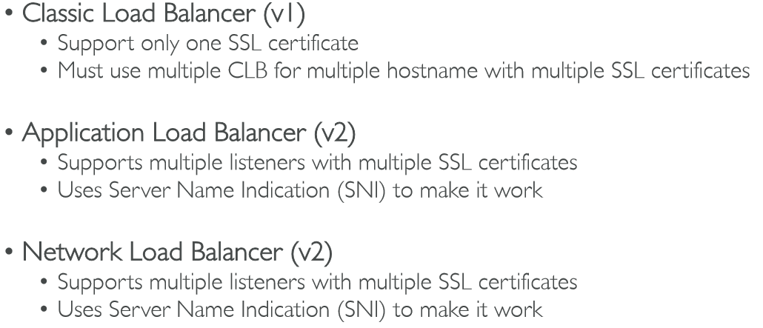
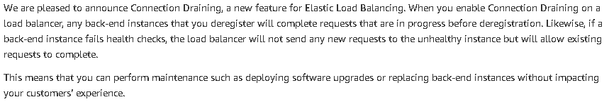
Additional features
Stickiness
Cross-Zone Load Balancing
SSL/TLS
Connection Draining / Deregistration Delay

Slide 7
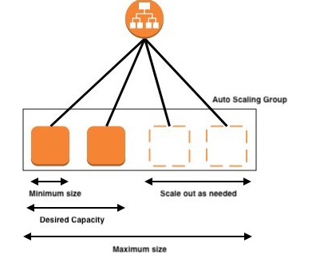
Auto Scaling Group
An Auto Scaling group contains a collection of Amazon EC2 instances that are treated as a logical grouping for the purposes of automatic scaling and management. An Auto Scaling group also enables you to use Amazon EC2 Auto Scaling features such as health check replacements and scaling policies.
In real-life, the load on your websites and application can change
In the cloud, you can create and get rid of servers very quickly
• The goal of an Auto Scaling Group (ASG) is to:
- Scale out (add EC2 instances) to match an increased load
- Scale in (remove EC2 instances) to match a decreased load
- Ensure we have a minimum and a maximum number of machines running
- Automatically Register new instances to a load balancer
It is possible to set an scaling based on cloud watch ALARM
practical

Slide 8
General ASG theory
Scaling policies can be on CPU, Network… and can even be on custom metrics or based on a schedule (if you know your visitors patterns)
ASGs use Launch configurations and you update an ASG by providing a new launch configuration
IAM roles attached to an ASG will get assigned to EC2 instances
ASG are free. You pay for the underlying resources being launched
Having instances under an ASG means that if they get terminated for whatever reason, the ASG will restart them. Extra safety!
ASG can terminate instances marked as unhealthy by an LB (and hence replace them
Scaling Cooldowns
The cooldown period helps to ensure that your Auto Scaling group doesn't launch or terminate additional instances before the previous scaling activity takes effect
Termination Policy
If there are multiple instances in the AZ to choose from, delete the one with the oldest launch configuration
Lifecycle Hooks – 300-7600
By default the new instance will go into in service
But with the LCH – It gives you ability to perform some action before making in service or
termination

Slide 9
Scaling policy
Target Tracking Scaling
With target tracking scaling policies, you select a scaling metric and set a target value. Amazon EC2 Auto Scaling creates and manages the CloudWatch alarms that trigger the scaling policy and calculates the scaling adjustment based on the metric and the target value. The scaling policy adds or removes capacity as required to keep the metric at, or close to, the specified target value. In addition to keeping the metric close to the target value, a target tracking scaling policy also adjusts to the changes in the metric due to a changing load pattern. It takes the Avarage
Step and Simple Scaling
With step scaling and simple scaling, you choose scaling metrics and threshold values for the CloudWatch alarms that trigger the scaling process. You also define how your Auto Scaling group should be scaled when a threshold is in breach for a specified number of evaluation periods. Its takes < than >
Scheduled Actions
Scheduled Actions • Anticipate a scaling based on known usage patterns • Example: increase the min capacity to 10 at 5 pm on Fridays

